Slide 1
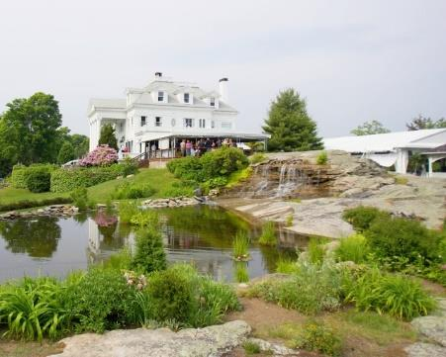
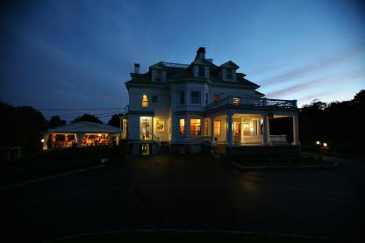
New Location
You are cordially invited to our 12th Annual Eastern CT Dinner Auction
In the Haley Mansion at the Inn at Mystic Three Williams Avenue • Mystic, CT 06355
Date: Friday, May 19th
Cocktail Reception at 6 PM, Dinner at 7 PM
Tickets: $ 80 per person ( includes your DU Membership), $125 per couple
Door Prizes, Raffles, Gun Raffles, Silent Auction & Live Auction.
Station Dining at it’s FINEST
Early-Bird Special: Buy a $100 Raffle Package, receive a Bonus $100 Raffle Package
Table Sponsor Package: Buy a Table of 8 for $640, receive $100 Raffle Package
MUST PURCHASE BY MAY 1, 2017
------------------------------------------------------------- -----------------------------
Name: ______________________________ Phone: ____________________
Number of Tickets: Couples ________ Single ______ Raffle Package_______
PLEASE SEND CHECKS PAYABLE TO: DUCKS UNLIMITED
C/O DU Treasurer
160 Kenwood Estates
Griswold, CT 06351

